Slide 1
Artificial Intelligence
Data
Science
Machine Learning
Deep Learning
Artificial Intelligence : Human Intelligence exhibited by machine.
Narrow AI : Computers can do a specific/one thing very well.
General AI : Computers can do multiple things like humans. We are very far away from this.
Machine Learning : Approach to try and achieve AI through systems that can find patterns in data. Stanford Univ - Science of getting computers to act without being explicitly programmed.
Deep Learning : One of the techniques to implement machine learning.
Data Science : Analysing Data

Slide 2
Play Ground
https://teachablemachine.withgoogle.com/
https://ml-playground.com/#

Slide 3
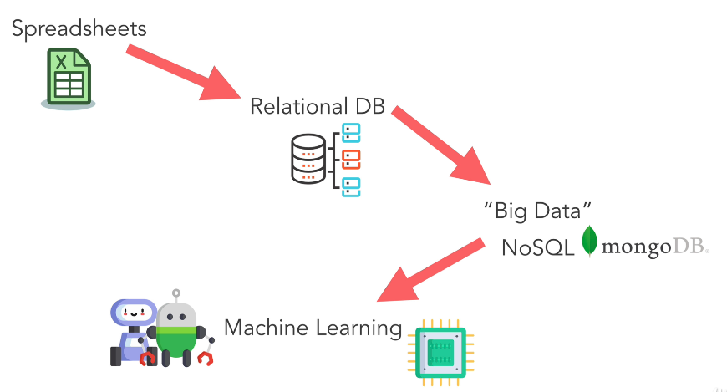
How did we get here ?

Slide 4
YouTube Recommendation Engine
https://ml-playground.com/#
X Axis - Duration of Video
Y Axis - Likes to the Video

Slide 5
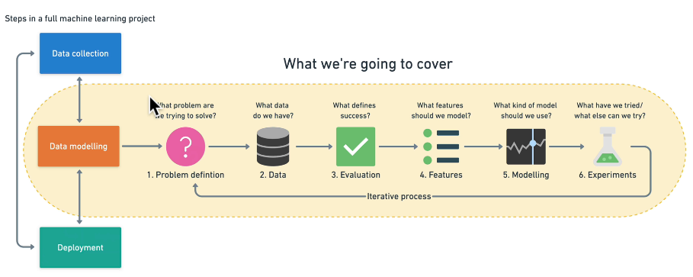
Framework

Slide 6
1. Problem Definition

Slide 7
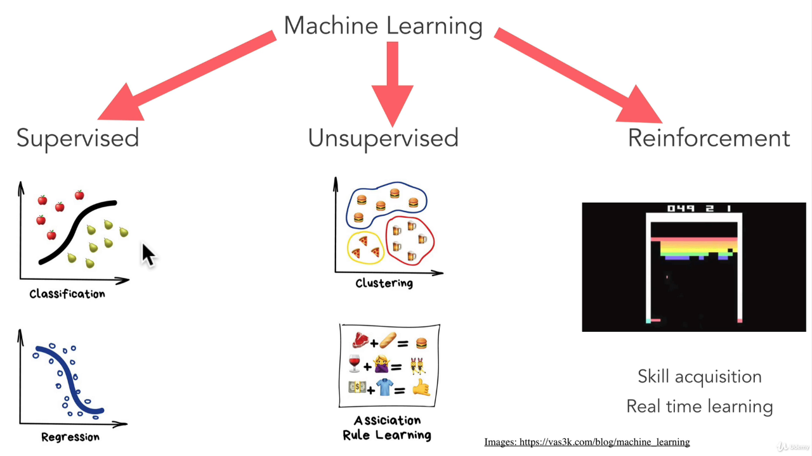
Types of machine learning
Is this a cat or dog ?
Machine
Categorizes
data
Predicting Stock prices
What customer
might buy ?

Slide 8
When not to use machine learning ?
Will simple hand coded instructions based system work ? If yes, then use it.

Slide 9
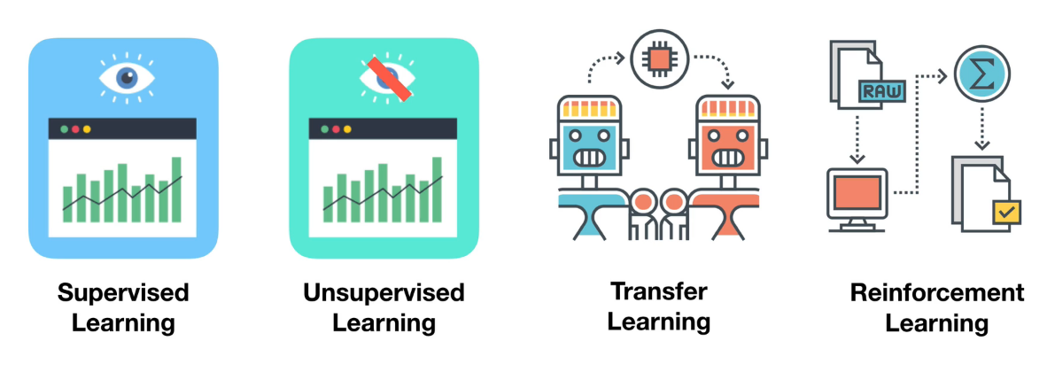
Main types of machine learning

Slide 10
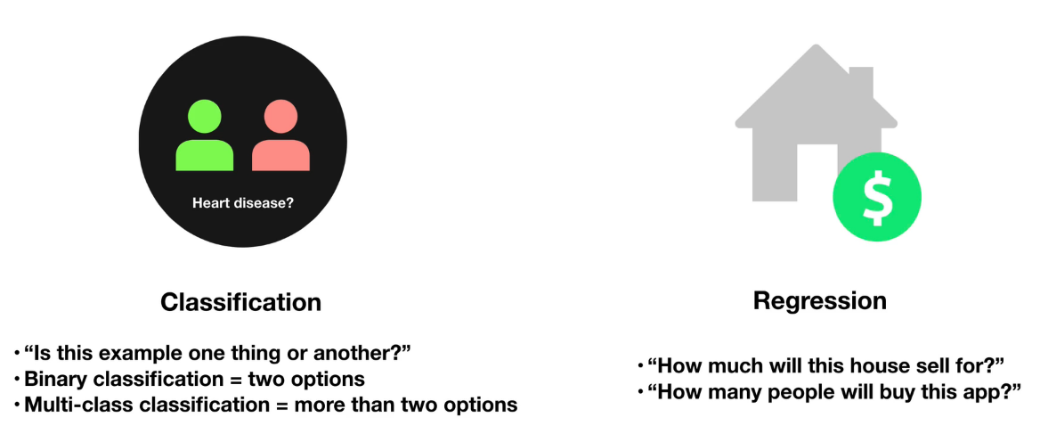
Supervised learning

Slide 11
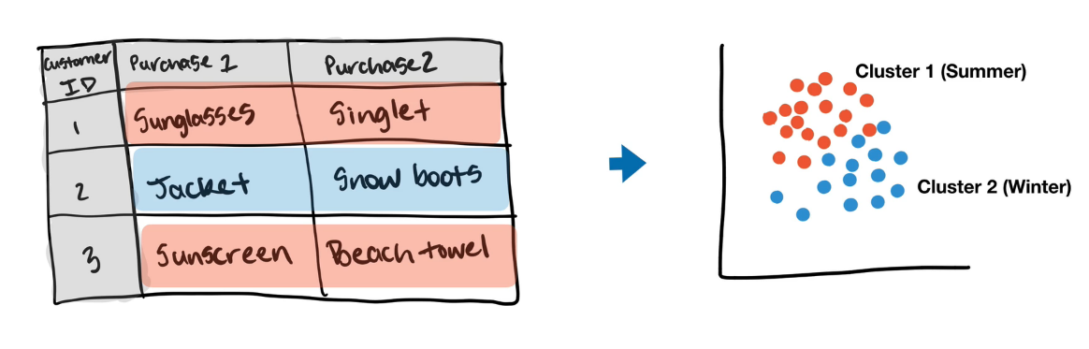
Unsupervised learning

Slide 12
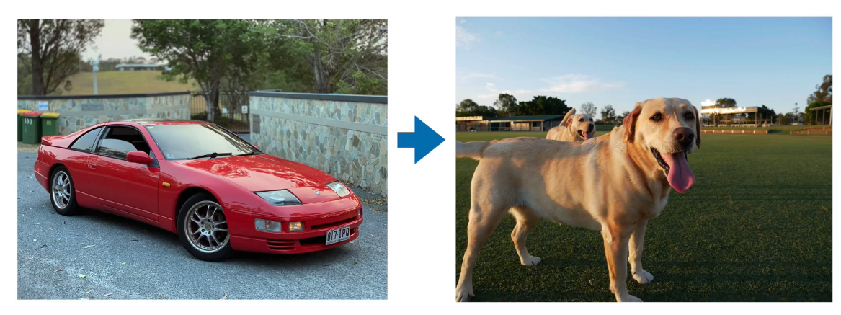
Transfer Learning

Slide 13
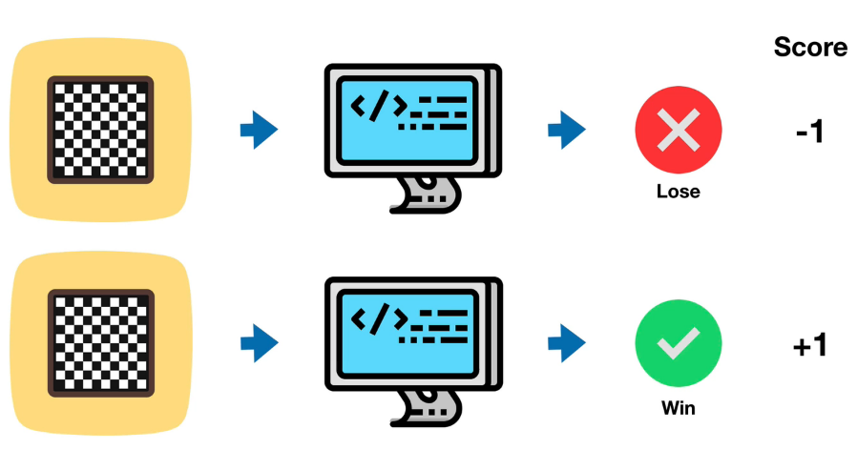
Reinforcement Learning

Slide 14
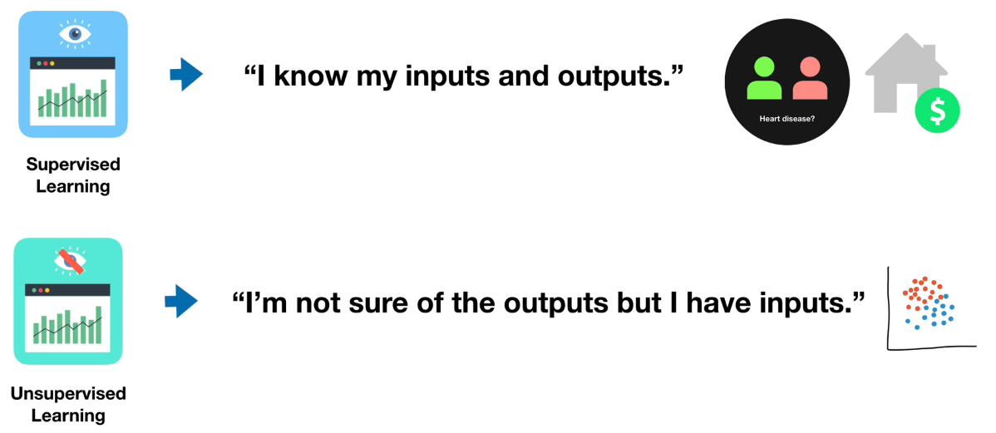
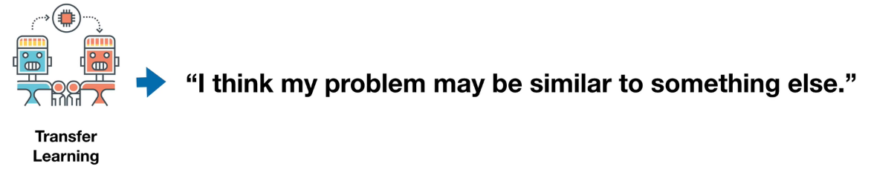
Problem Definition Matching your problem

Slide 15
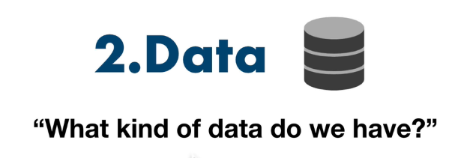

Slide 16
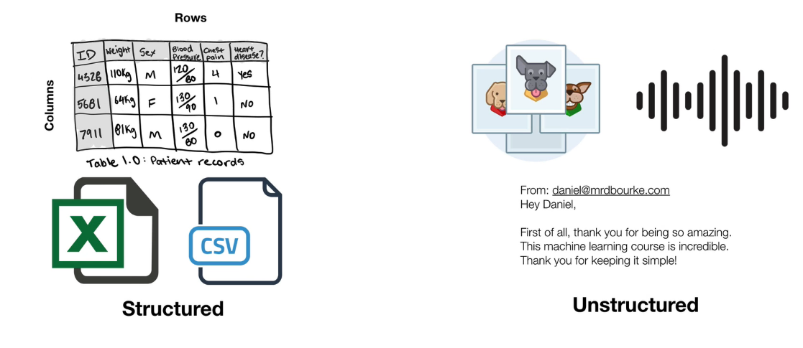
Types of Data

Slide 17
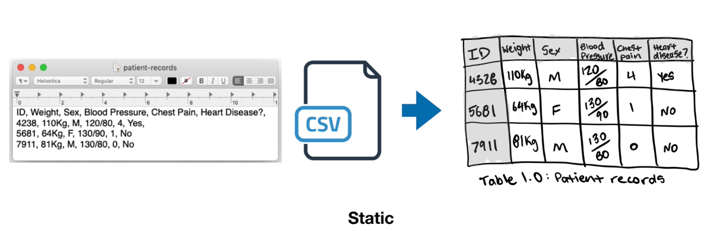
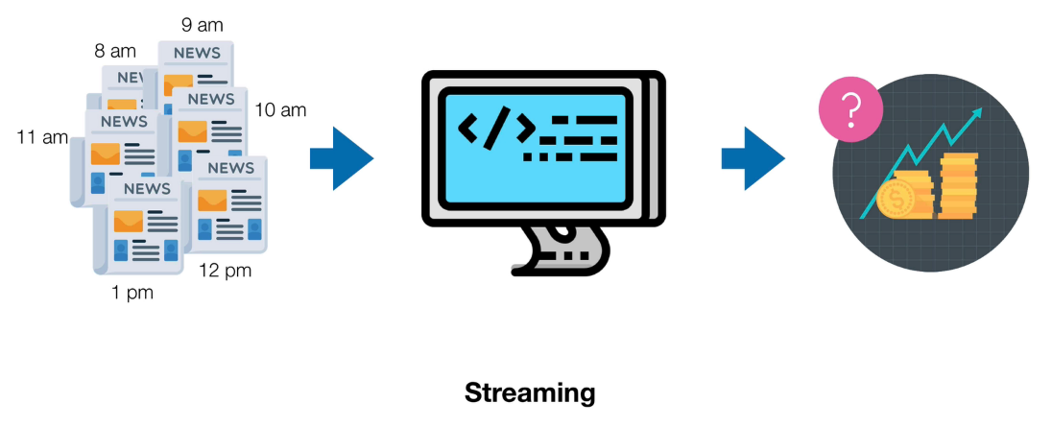
Types of Data ….

Slide 18
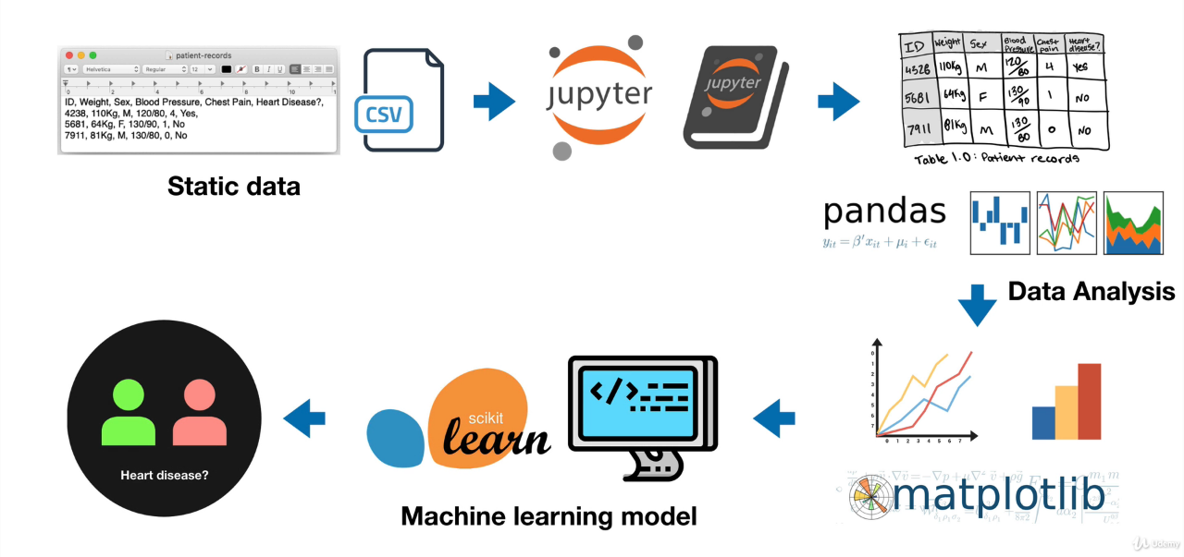
A data science workflow

Slide 19
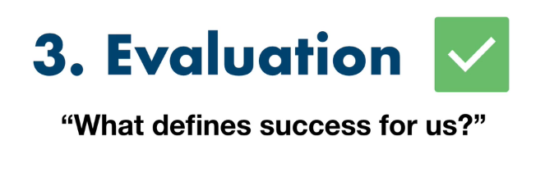

Slide 20
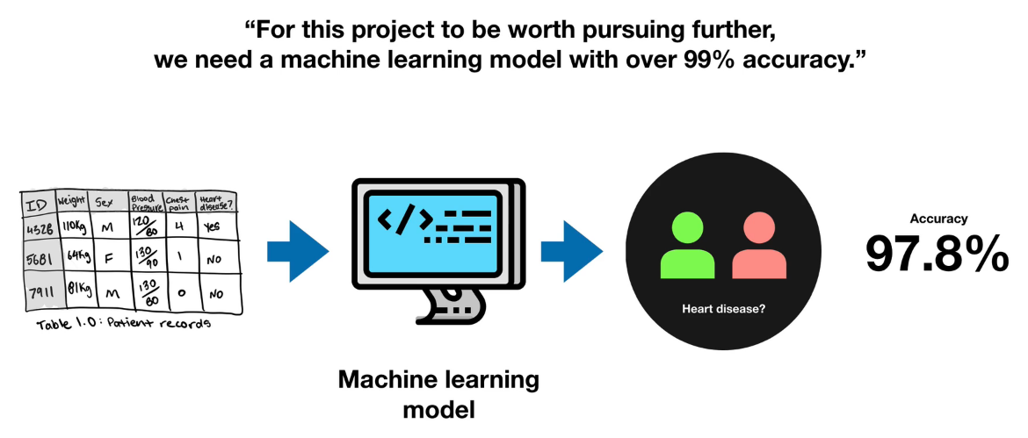

Slide 21
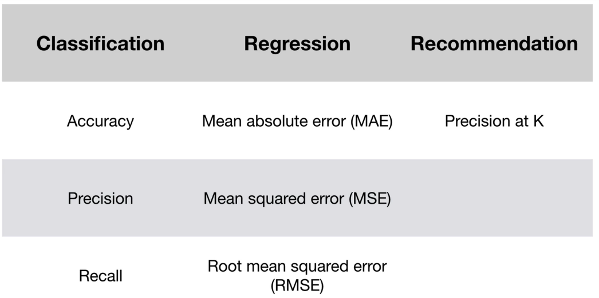
Types of metrics

Slide 22
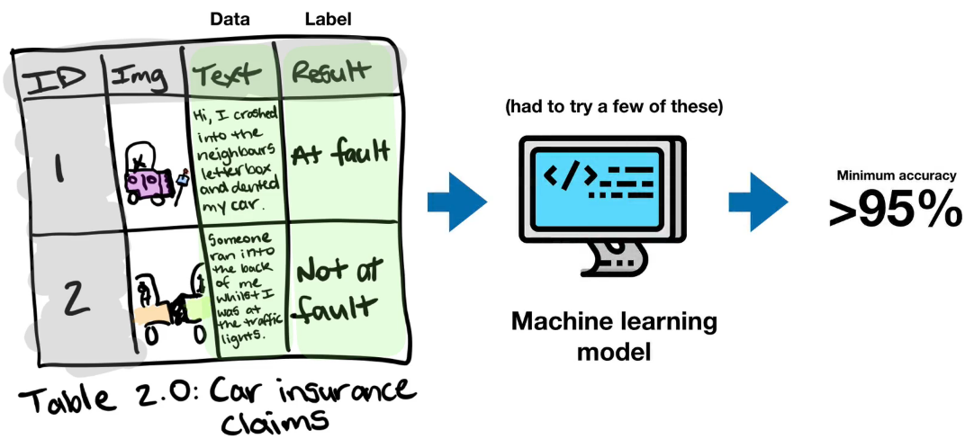
Classifying Car insurance claims

Slide 23
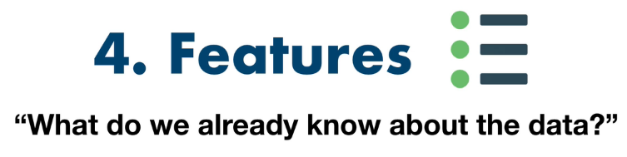

Slide 24
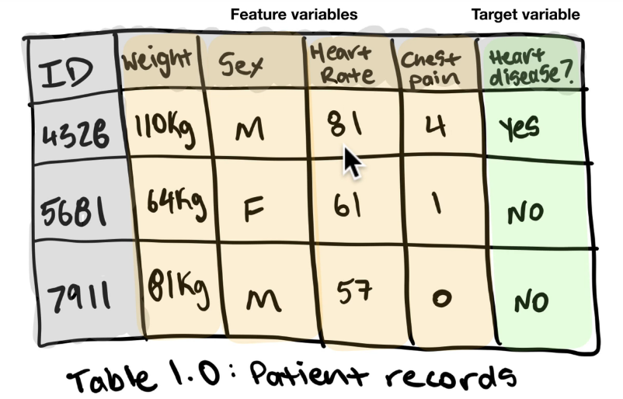
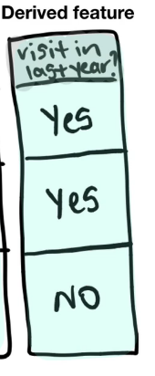
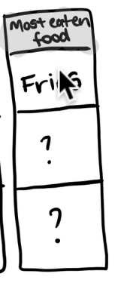
Feature variables can be
Numerical
Categorical
Feature engineering
Deriving new features from existing one.
Feature Coverage
- Checking if values are correctly populated for a feature or not ? Do not use it if it is not well covered.

Slide 25
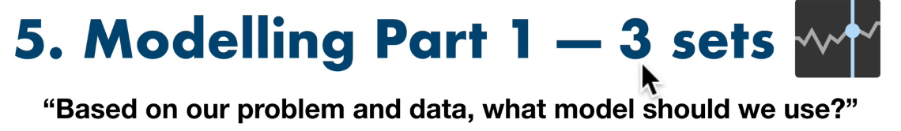

Slide 26
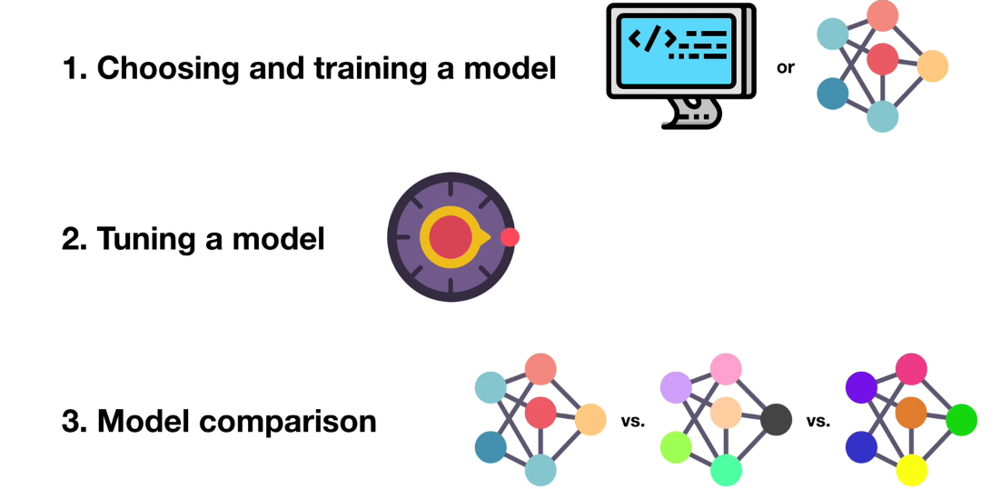
3 parts to modelling

Slide 27
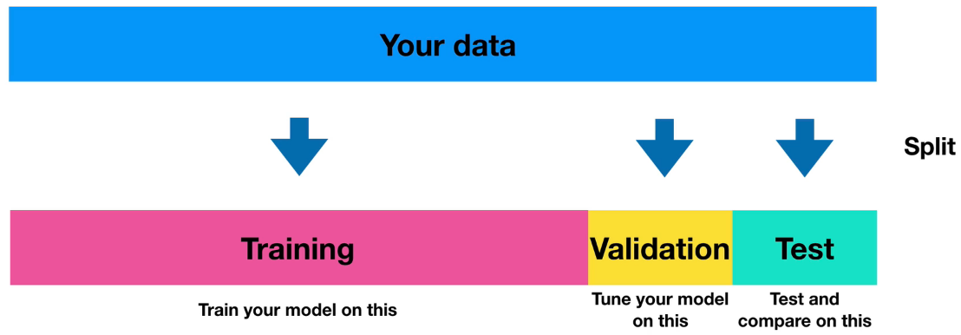
Training, validation and test sets
70-80% 10-15% 10-15%

Slide 28
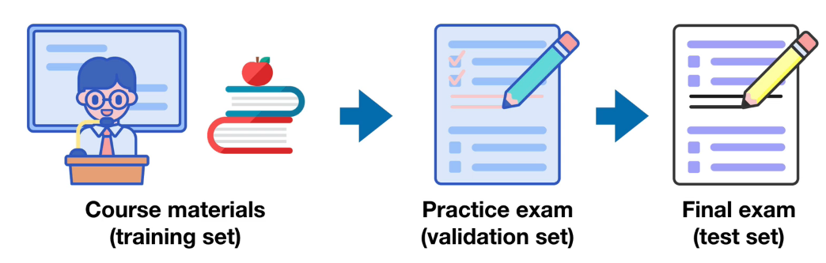
3 sets
Generalization – The ability for a machine learning model to perform well on data it hasn’t seen before.

Slide 29
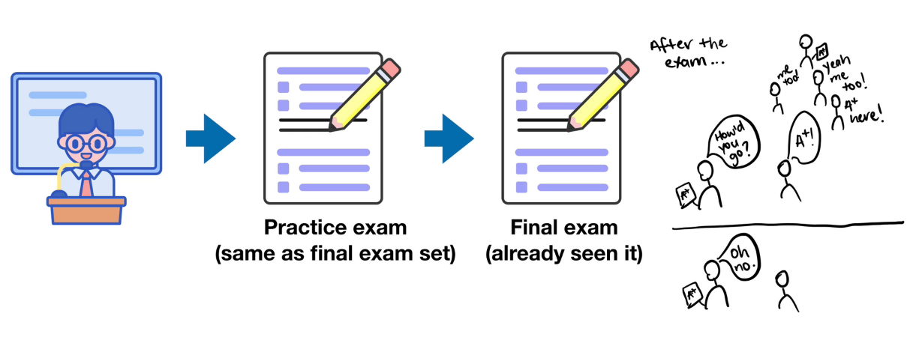
When things go wrong ?
Machine really did not learn anything, it just memorized what it solved in training part.

Slide 30
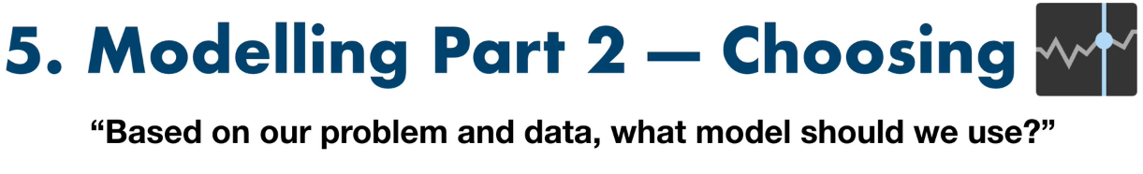

Slide 31
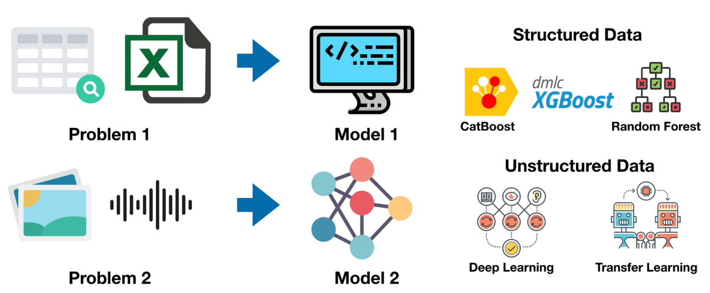
Choosing a model

Slide 32
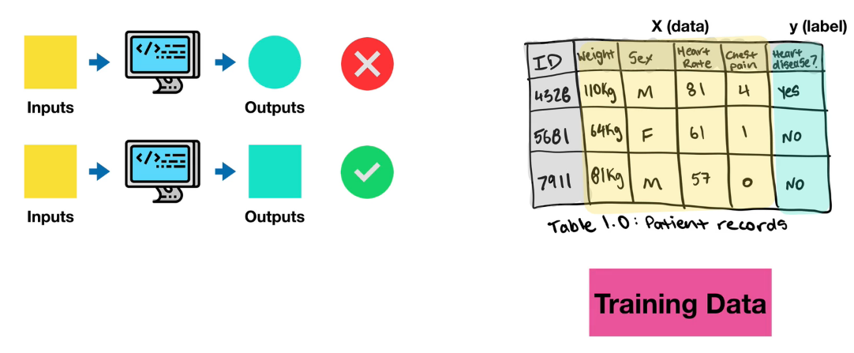
Training a model

Slide 33
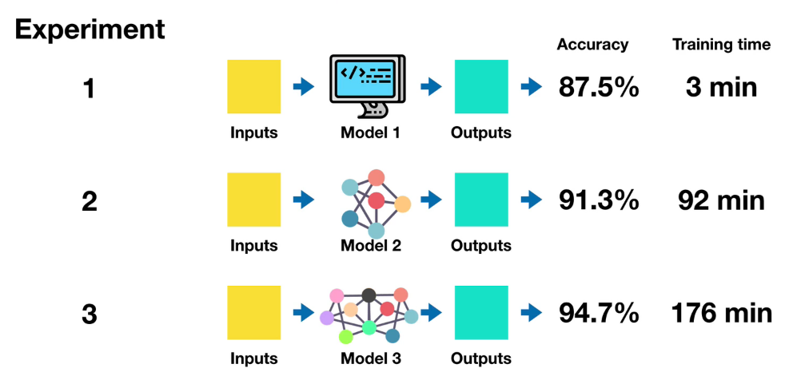
Goal - Minimize time between experiments
Sometimes for smaller %age extra of Accuracy, we end up spending lot of time. We should avoid that.

Slide 34
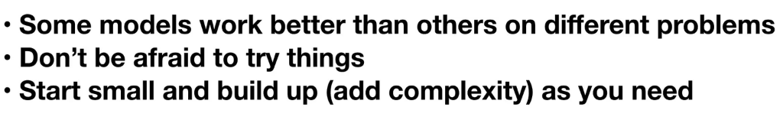
Remember

Slide 35
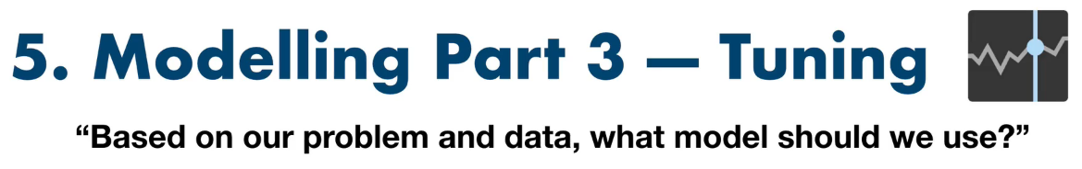

Slide 36
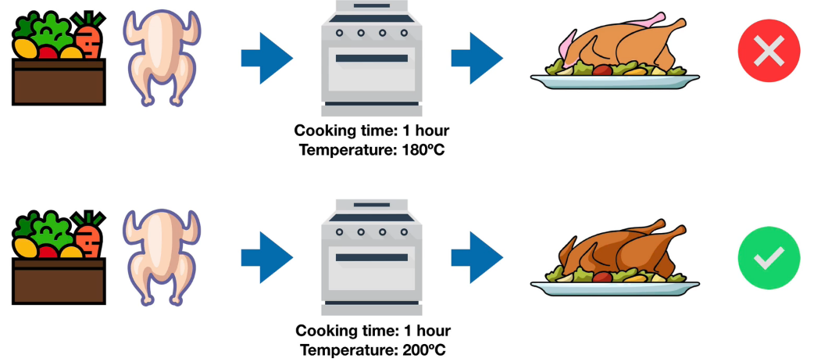
Tuning

Slide 37
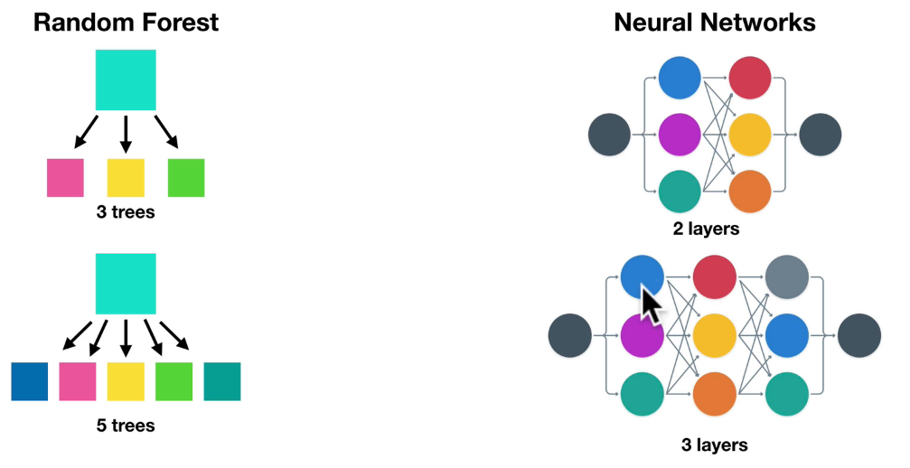
Tuning…

Slide 38
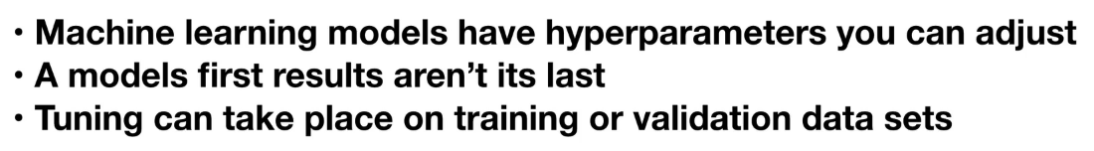
Remember

Slide 39
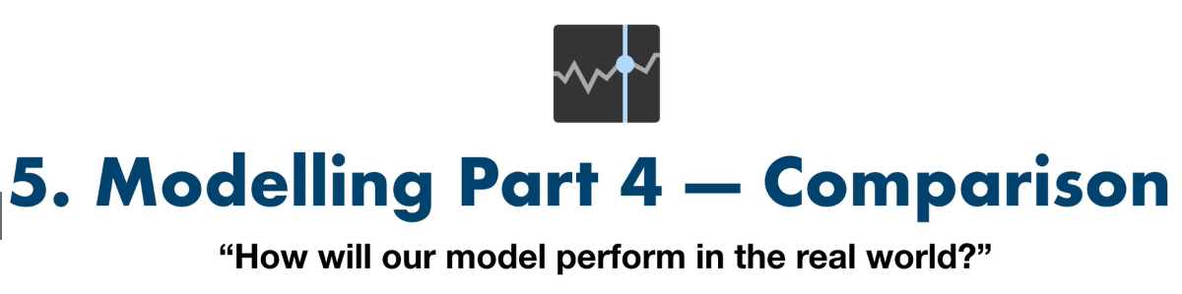

Slide 40
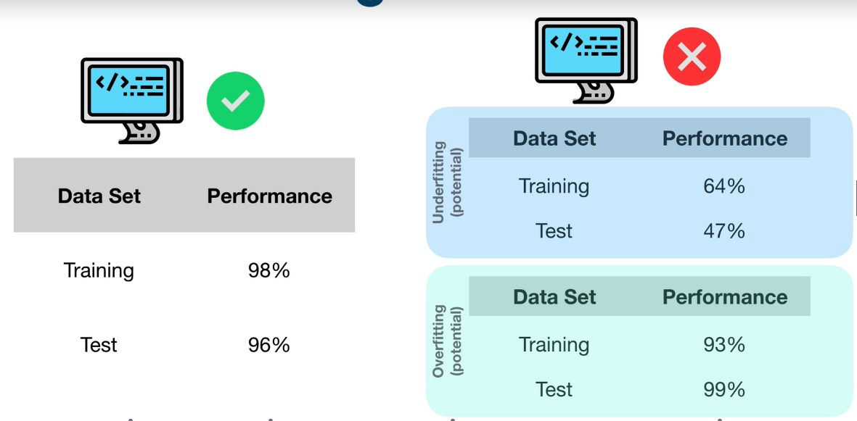
Model performance

Slide 41
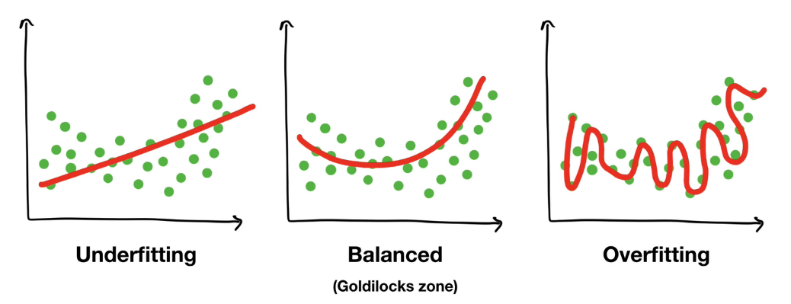
Overfitting and Underfitting

Slide 42
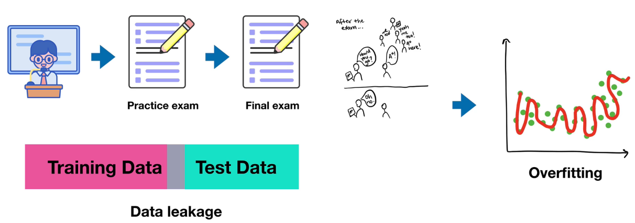
Overfitting and Underfitting

Slide 43
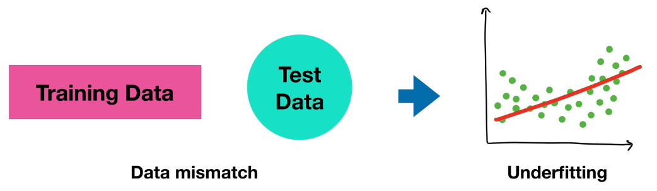
Overfitting and Underfitting

Slide 44
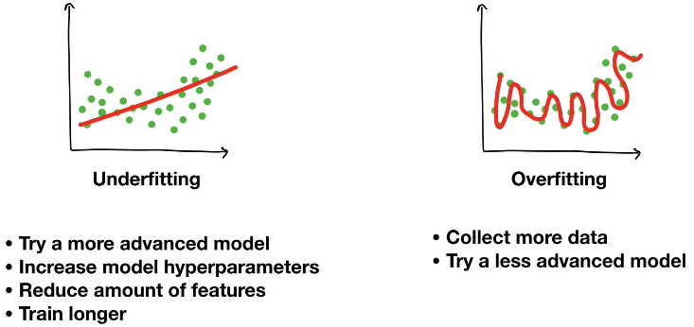
Fixes for Overfitting and Underfitting

Slide 45
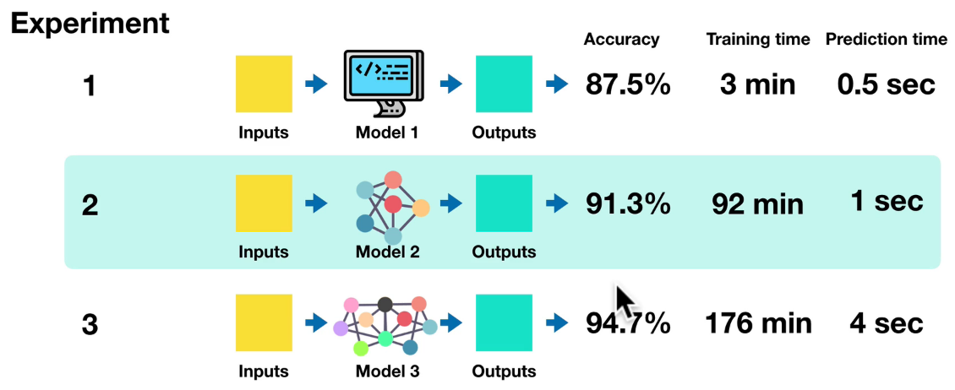
Comparison

Slide 46
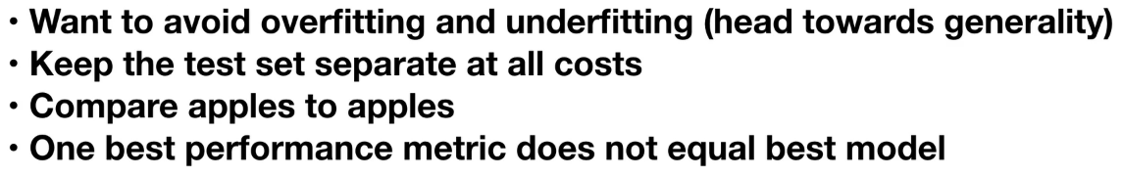
Remember

Slide 47
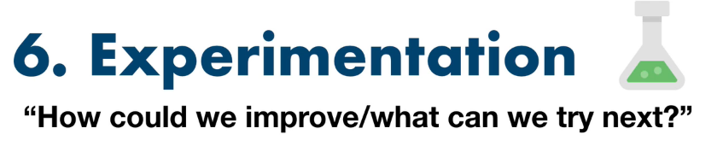

Slide 48
Experimentation
Try out a different approach for improving the machine learning model

Slide 49
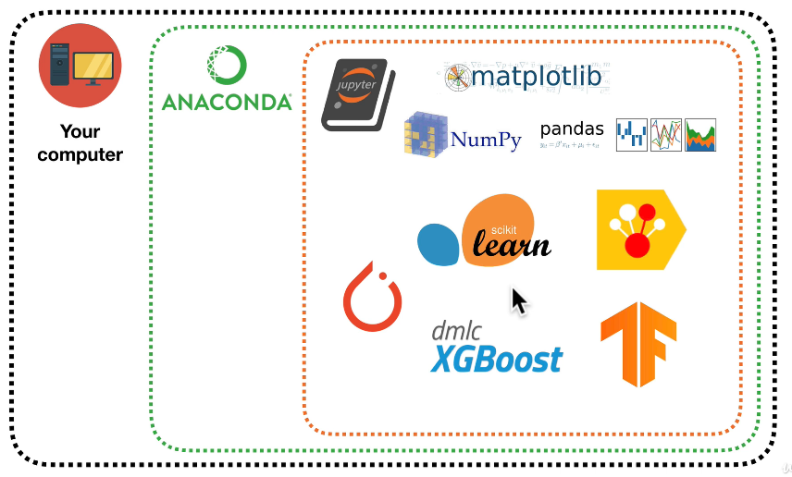
Tools

Slide 50
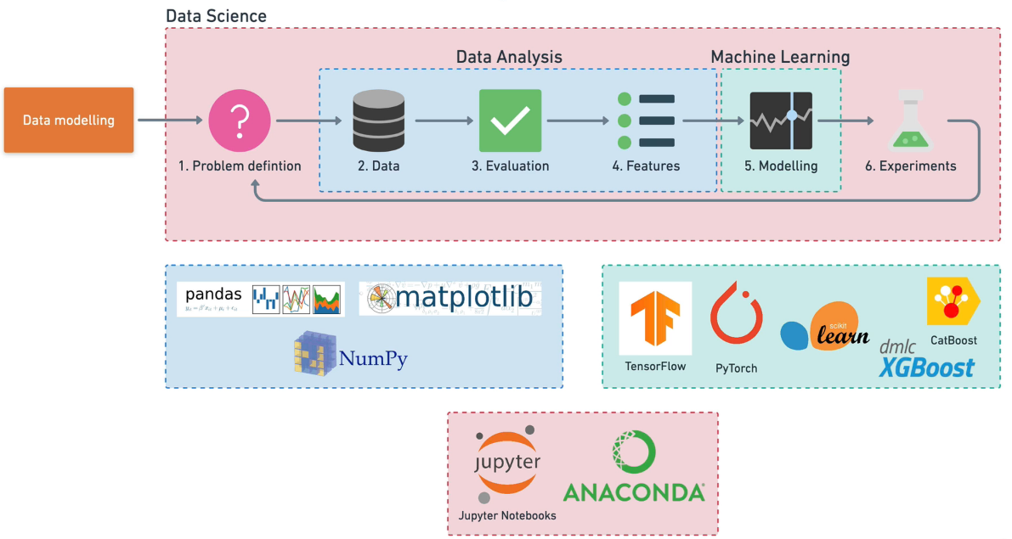
Tools mapping

